Slide 1
GOOD HABITS

Slide 2
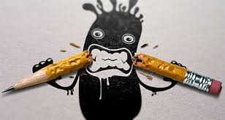
1ºPay atention in class. 2ºTake down notes.

Slide 3
3ºwrite down the date in your folder every day. 4ºask your teacher if you don´t understant.

Slide 4
5ºkeep your desk clear and organised. 6ºchek your schedule daily.

Slide 5
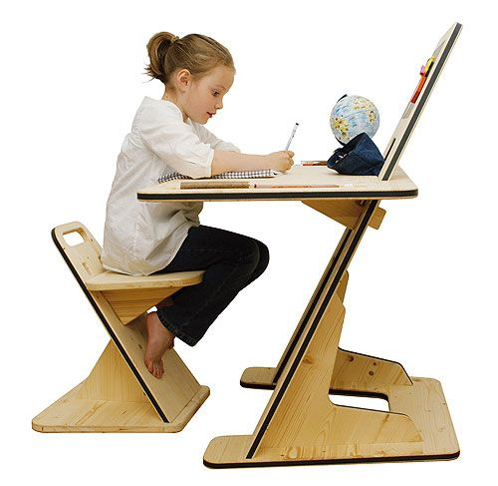
7ºwhen you study at home turn off the tv and and your mobile phone. 8ºrevise a little bit every day.

