Slide 1
WOMEN WHO MADE HISTORY PASSING BY MEN

Slide 2
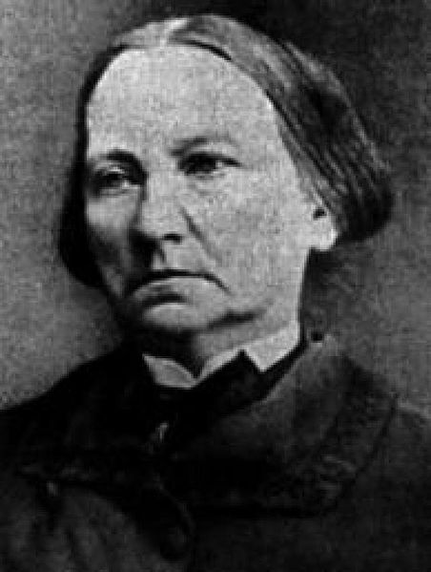
Concepción Arenal Ponte

Slide 3
birth
She studied
Others things
died
Ferrol
Right
31 of january, 1820
At the age of 21, in order to enter the Law Faculty of the Central University of Madrid, he had to disguise himself as a man, cut his hair and wore a cape and top hat.
Vigo
Also dressed as a man, Concepción, with liberal and progressive ideas, participated in politics and collaborated in the newspaper La Iberia.
1893, 93 years old

Slide 4
End
Thanks for the attention uwu

