Slide 1
Unit 4
BOOKS
End of unit task

Slide 2
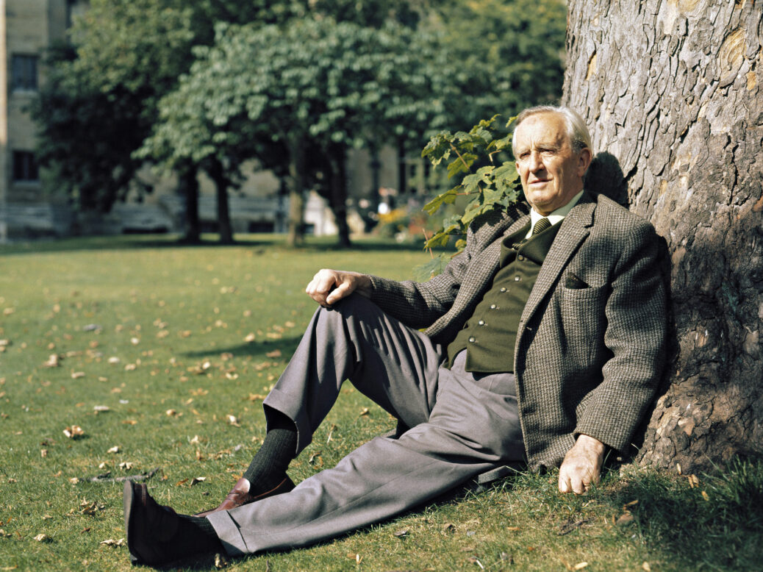
Do you recognise this man?

Slide 3
Do you recognise this man?
J. R. R. Tolkien
What does J. R. R. stand for? Can you guess?

Slide 4
Do you recognise this man?
J. R. R. Tolkien
What does J. R. R. stand for? Can you guess?
John Ronald Reuel Tolkien

Slide 5
Why did we choose Tolkien?
2023 is the 50th Anniversary of Tolkien’s Death
“J.R.R. Tolkien passed away in 1973.
If you reverse that number it is 3791…
Three rings for the Elves.
Seven for the Dwarves.
Nine for Men.
And one ring to rule them all.”
As seen in Reddit.

Slide 6
Some questions to introduce him… and to discuss in the groups/pairs
Are you familiar with Tolkien’s work?
If not, have you heard his name before? When/in which contexts?
If you are familiar with it, how were you introduced to his work?
What is your favourite part of Tolkien’s work?
What is your fondest experience of Tolkien’s work?
Has the way you approach Tolkien’s work changed over time?
Would you ever recommend Tolkien’s work? Why/Why not?

Slide 7
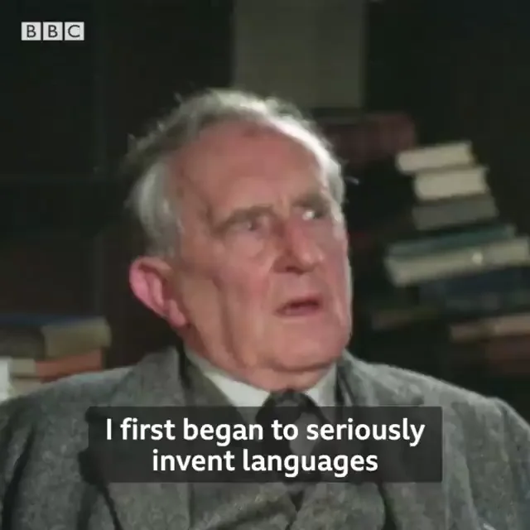
Languages, World War I and other influences
J. R. R. Tolkien's fantasy books on Middle-earth, especially The Lord of the Rings and The Silmarillion, drew on a wide array of influences including language, Christianity, mythology, archaeology, ancient and modern literature, and personal experience, such as World War I.
He was inspired primarily by his profession, philology; his work centred on the study of Old English literature, especially Beowulf, and he acknowledged its importance to his writings.
He was a gifted linguist, influenced by Germanic, Celtic, Finnish, Slavic, and Greek language and mythology.
https://www.reddit.com/r/STEW_ScTecEngWorld/comments/168muef/languages_have_a_flavour_to_me_j_r_r_tolkien_died/?rdt=42548

Slide 8
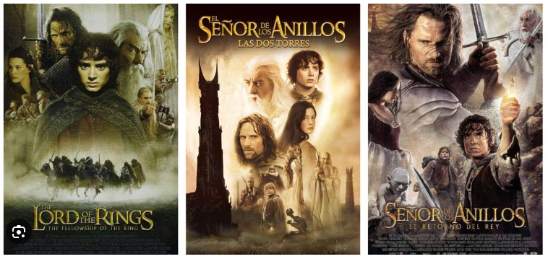
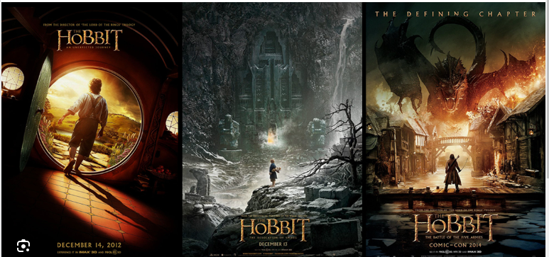
Most people know….

Slide 9
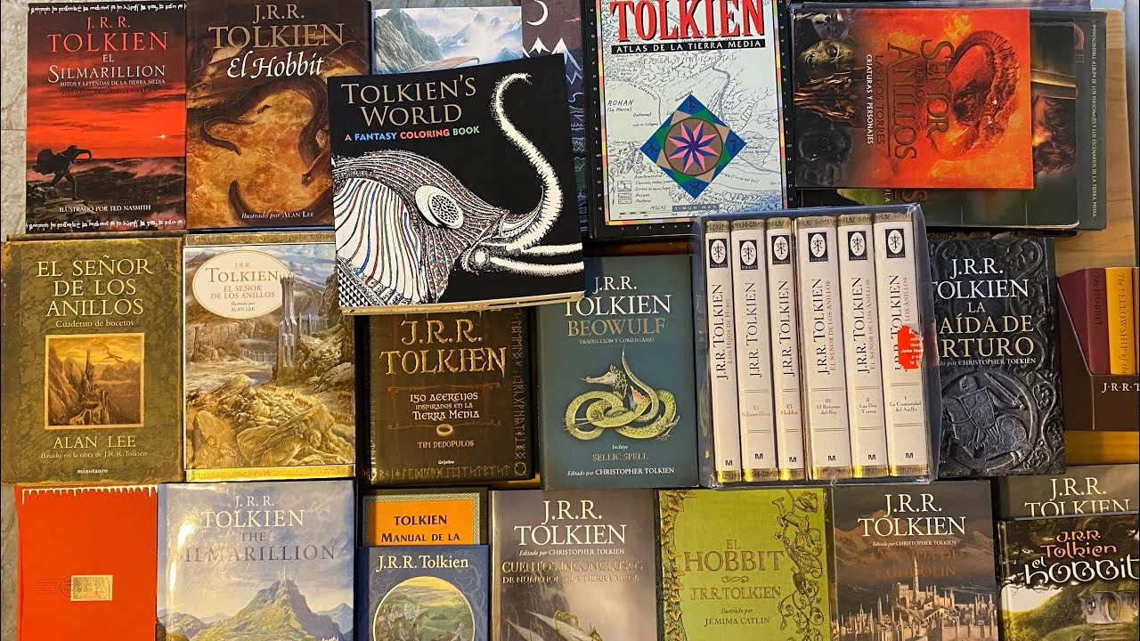
Some people know….

Slide 10
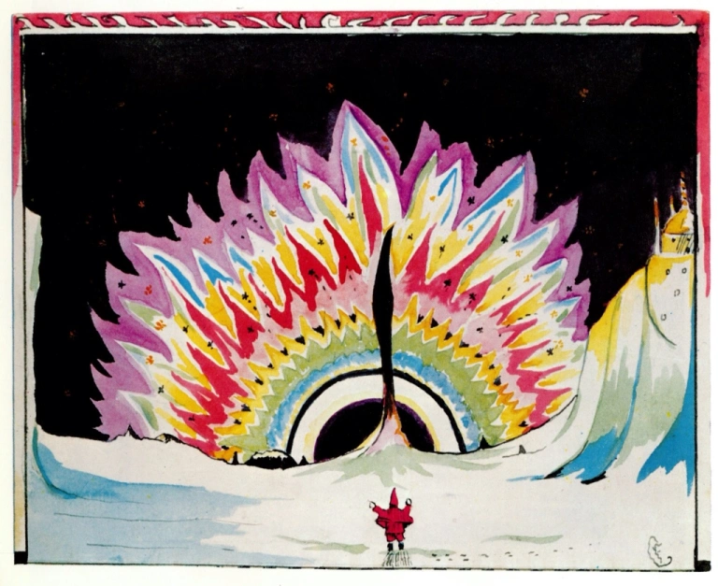
A few people know….

Slide 11
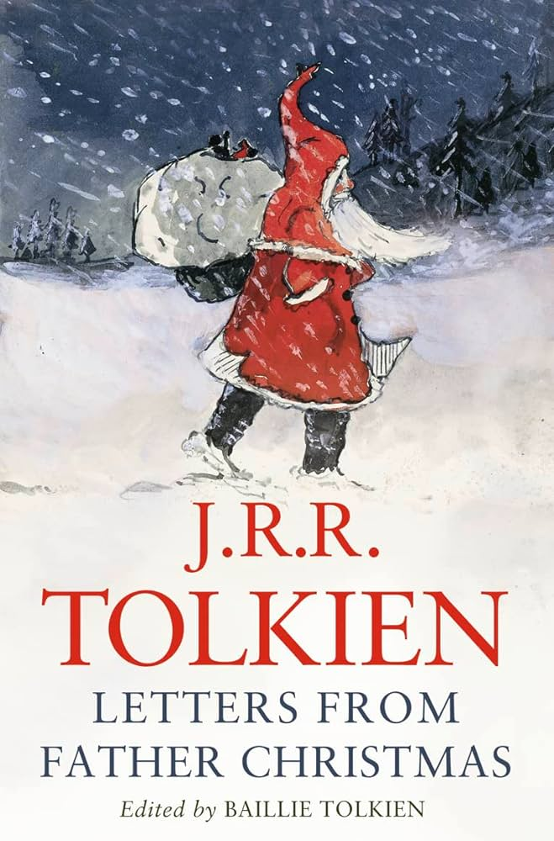
A few people know….
Letters from Father Christmas, are a collection of real letters written and illustrated by J.R.R. Tolkien between 1920 and 1943 for his children, from Father Christmas.
They were released posthumously by the Tolkien Estate on 2 September 1976, the 3rd anniversary of Tolkien's death.
They were edited by Baillie Tolkien, second wife of his youngest son, Christopher.
The book was warmly received by critics, and it has been suggested that elements of the stories inspired parts of Tolkien's The Lord of the Rings.

Slide 12
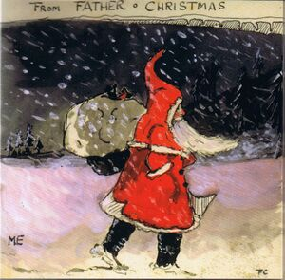
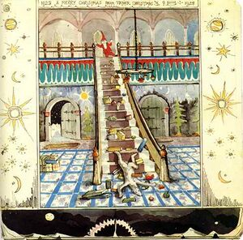
Letters from Father Christmas
The stories have the format of a series of letters, told either from the point of view of Father Christmas or his elvish secretary. They document the adventures and misadventures of Father Christmas and his helpers, including the North Polar Bear and his two sidekick cubs, Paksu and Valkotukka. The stories include descriptions of the massive fireworks that create the northern lights and how Polar Bear manages to get into trouble on more than one occasion.
https://tolkiengateway.net/wiki/Letters_from_Father_Christmas

Slide 13
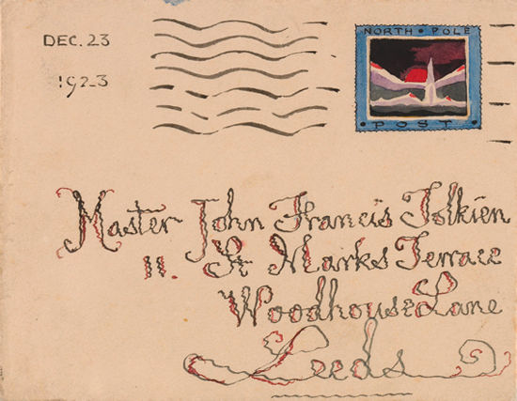
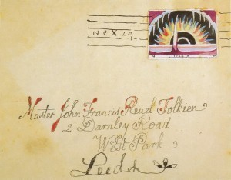
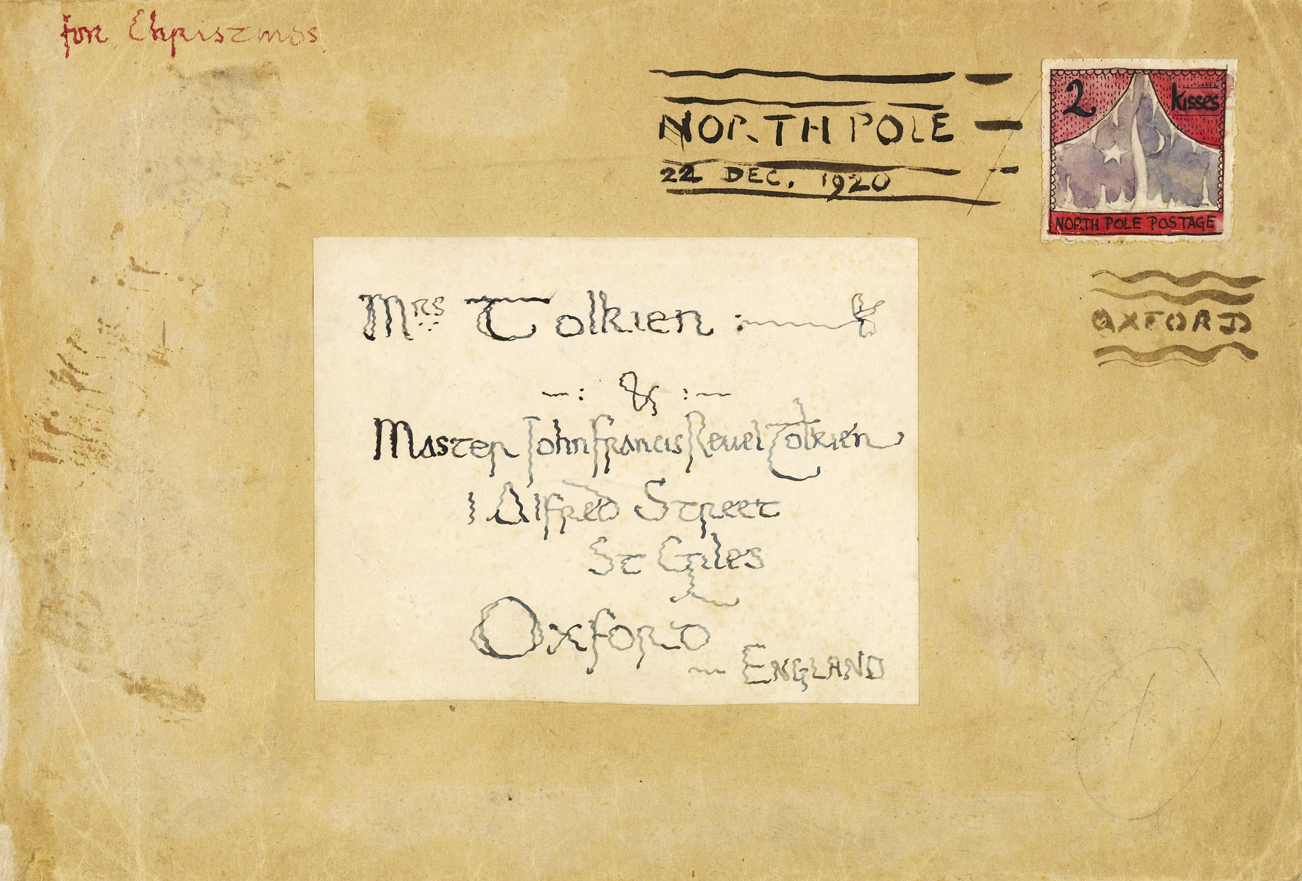
Letters from Father Christmas
The letters themselves were written over a period of over 20 years to entertain Tolkien's children each Christmas. Starting in 1920 when Tolkien's oldest son was aged three, each Christmas Tolkien would write a letter from Father Christmas about his travels and adventures.
Each letter was delivered in an envelope, including North Pole stamps and postage marks as designed by Tolkien.
https://tolkiengateway.net/wiki/Letters_from_Father_Christmas

Slide 14
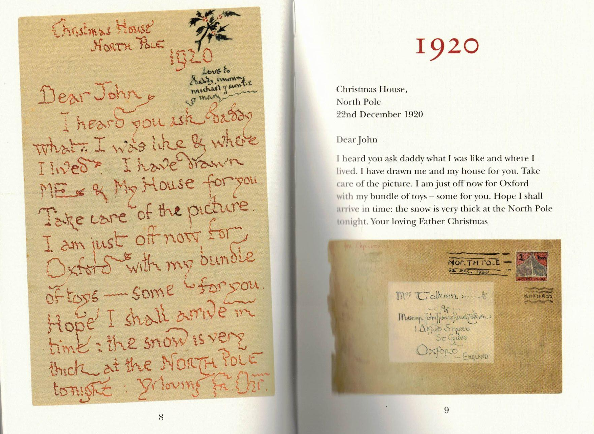

Slide 15
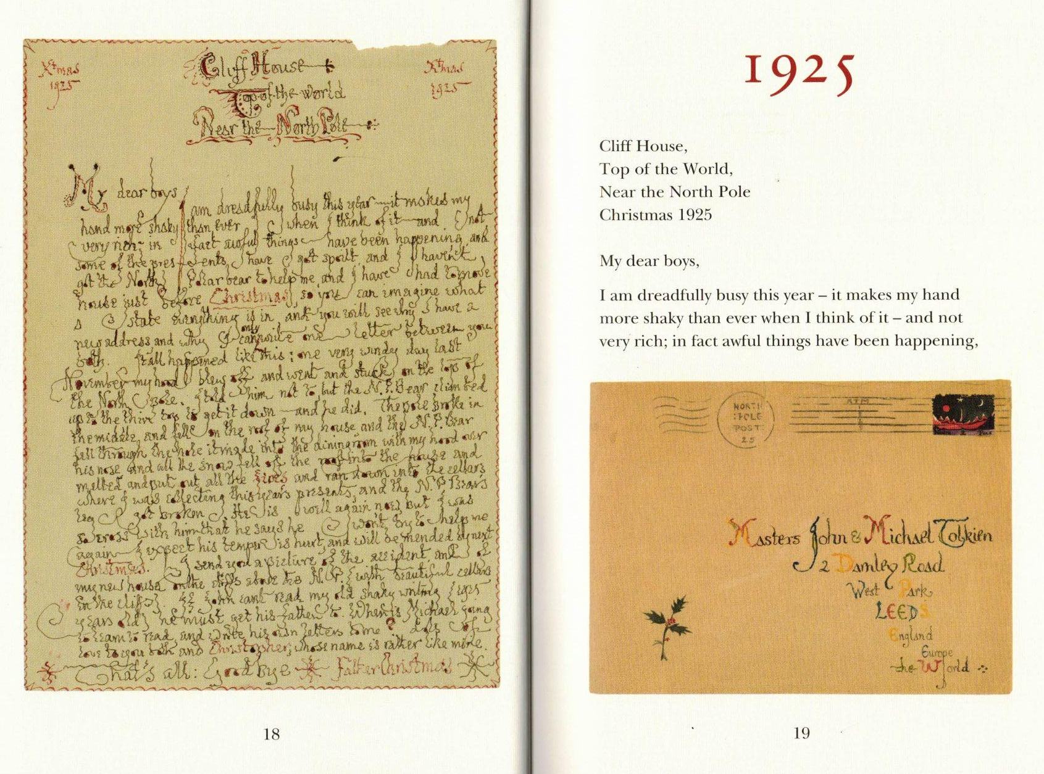

Slide 16
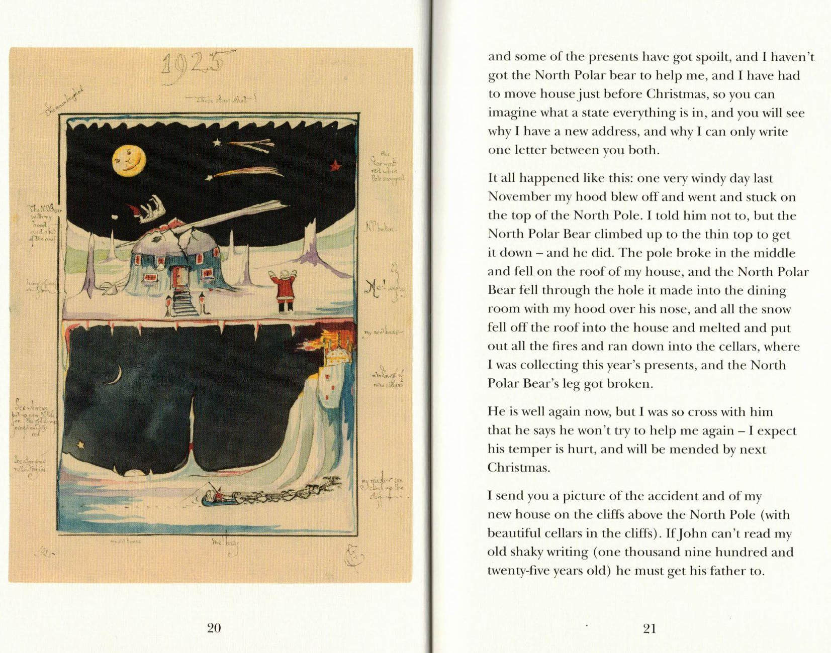

Slide 17
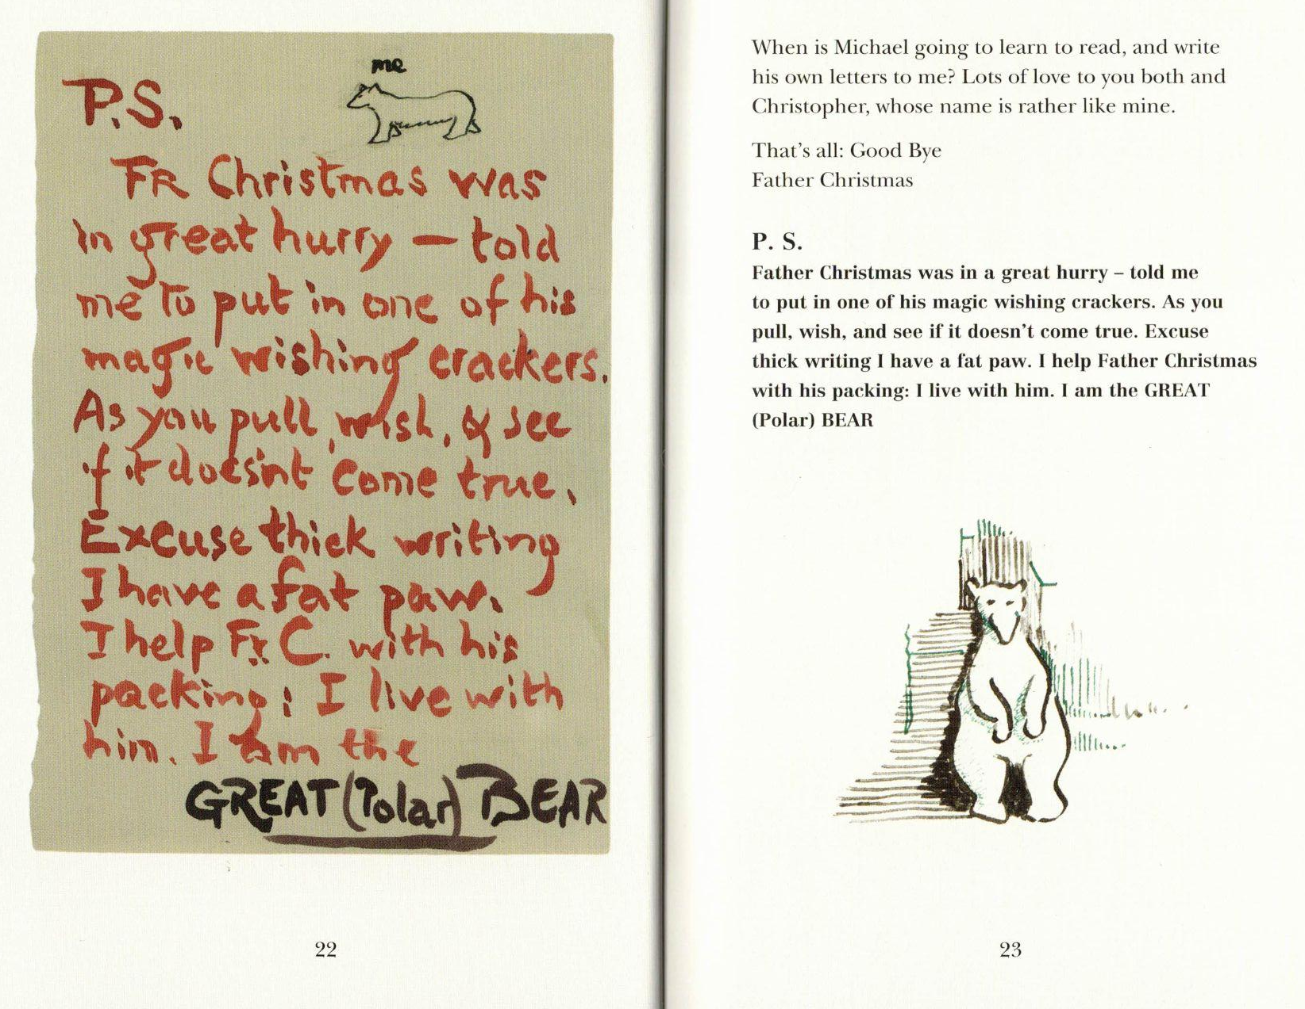

Slide 18
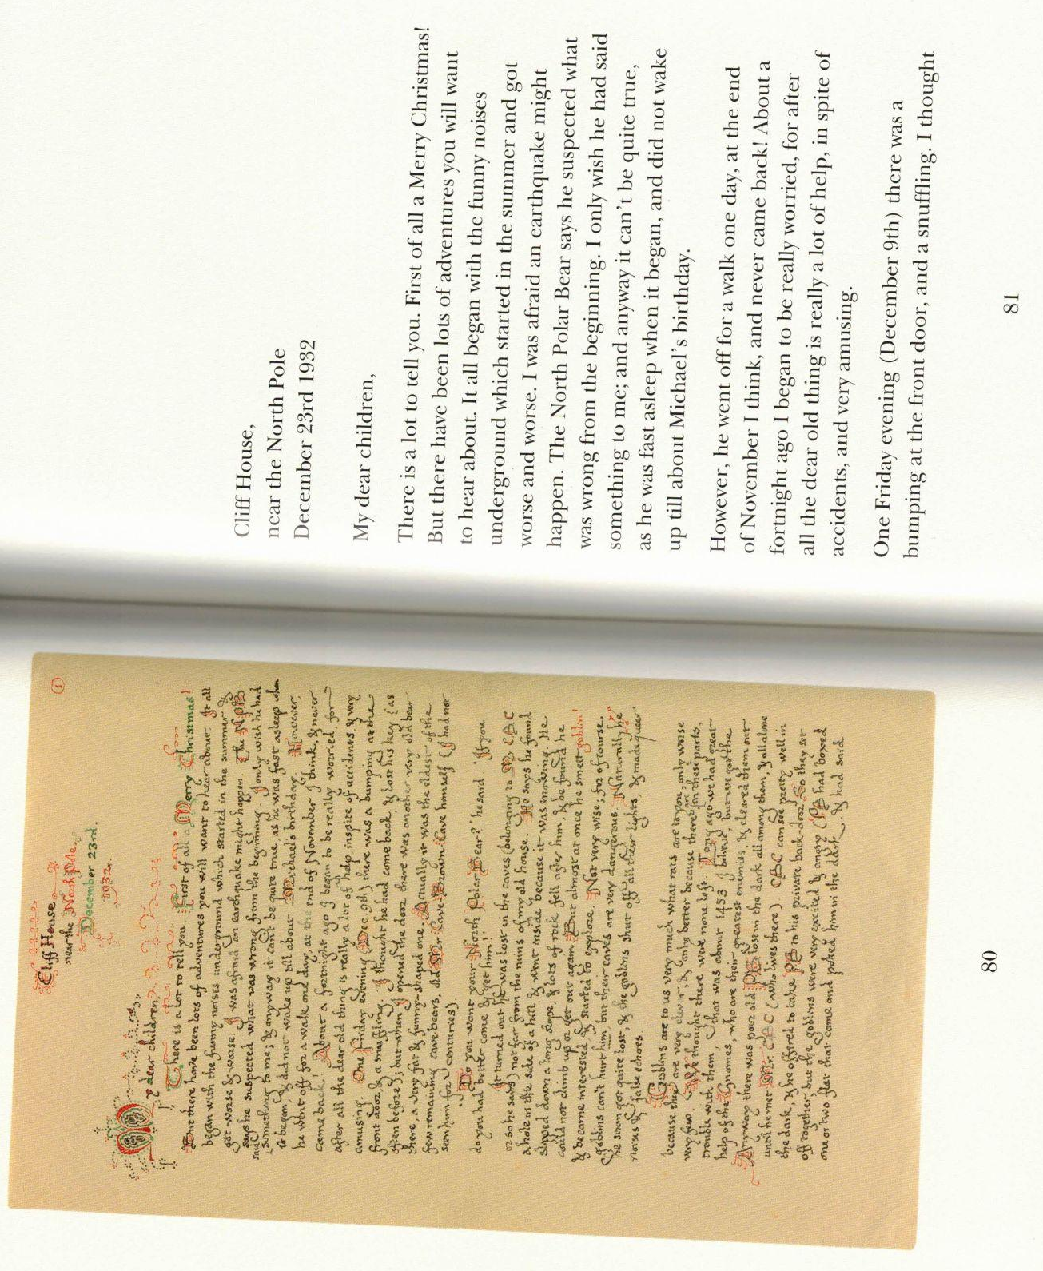

Slide 19
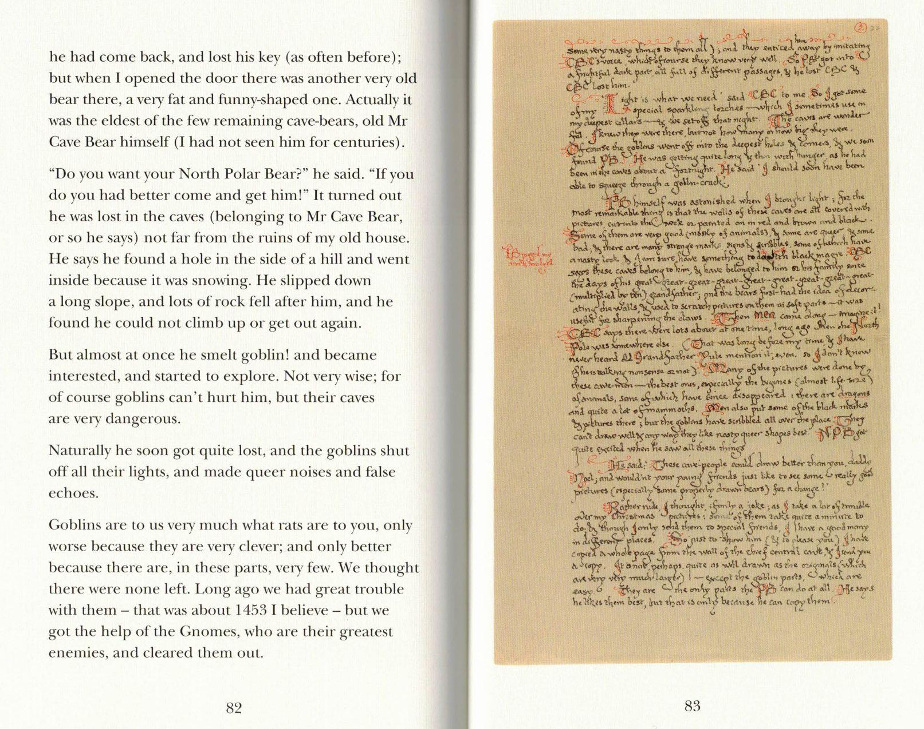

Slide 20
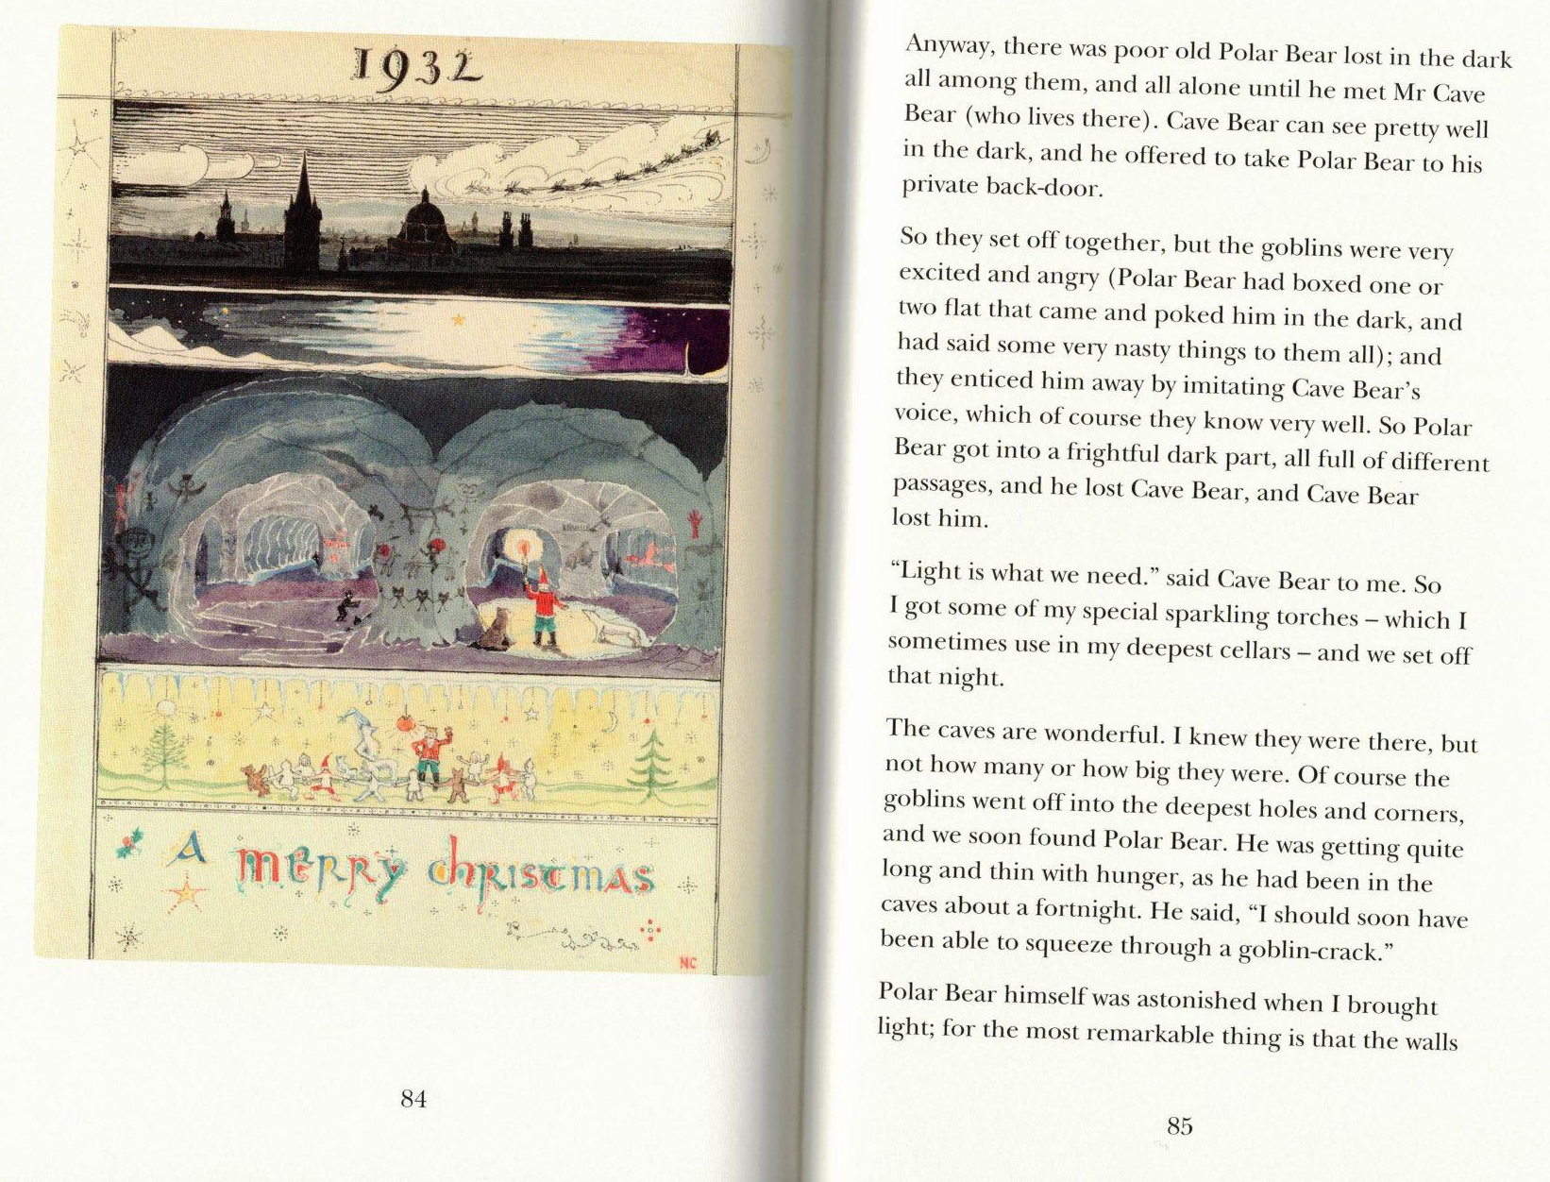

Slide 21
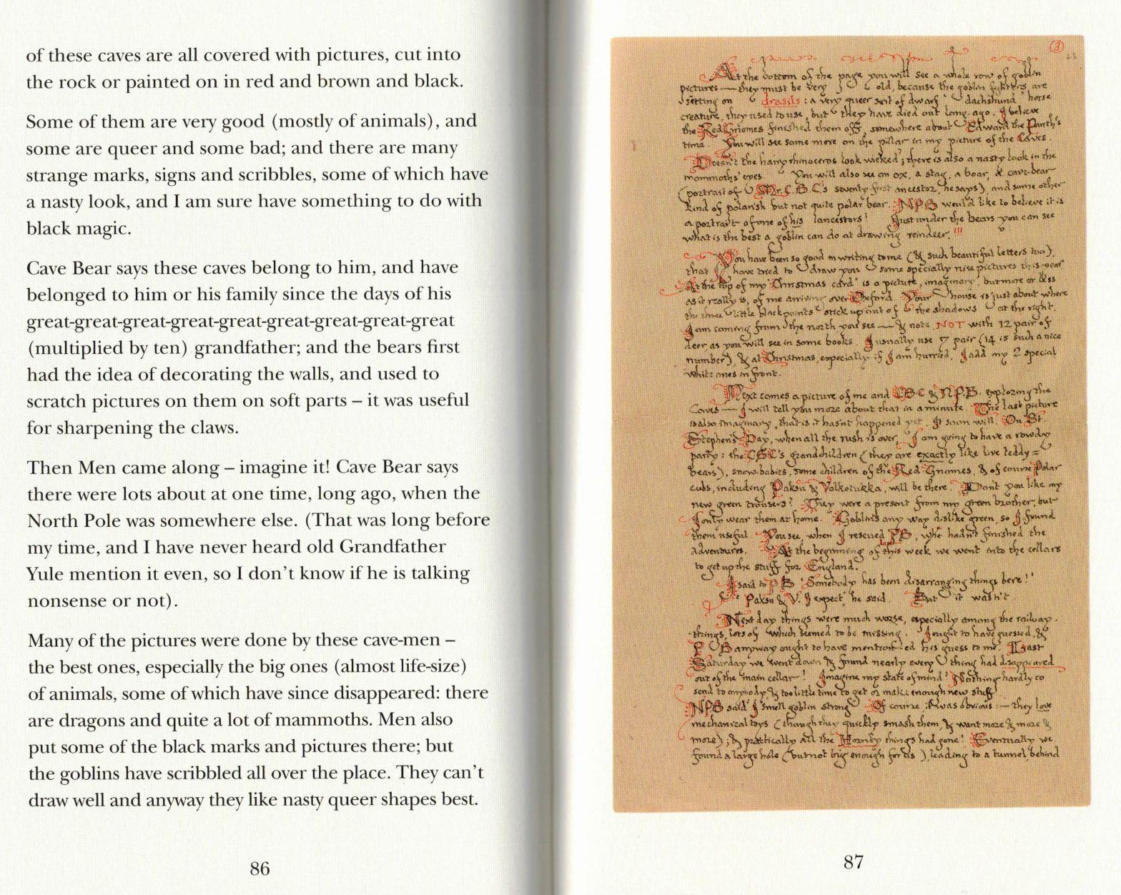

Slide 22
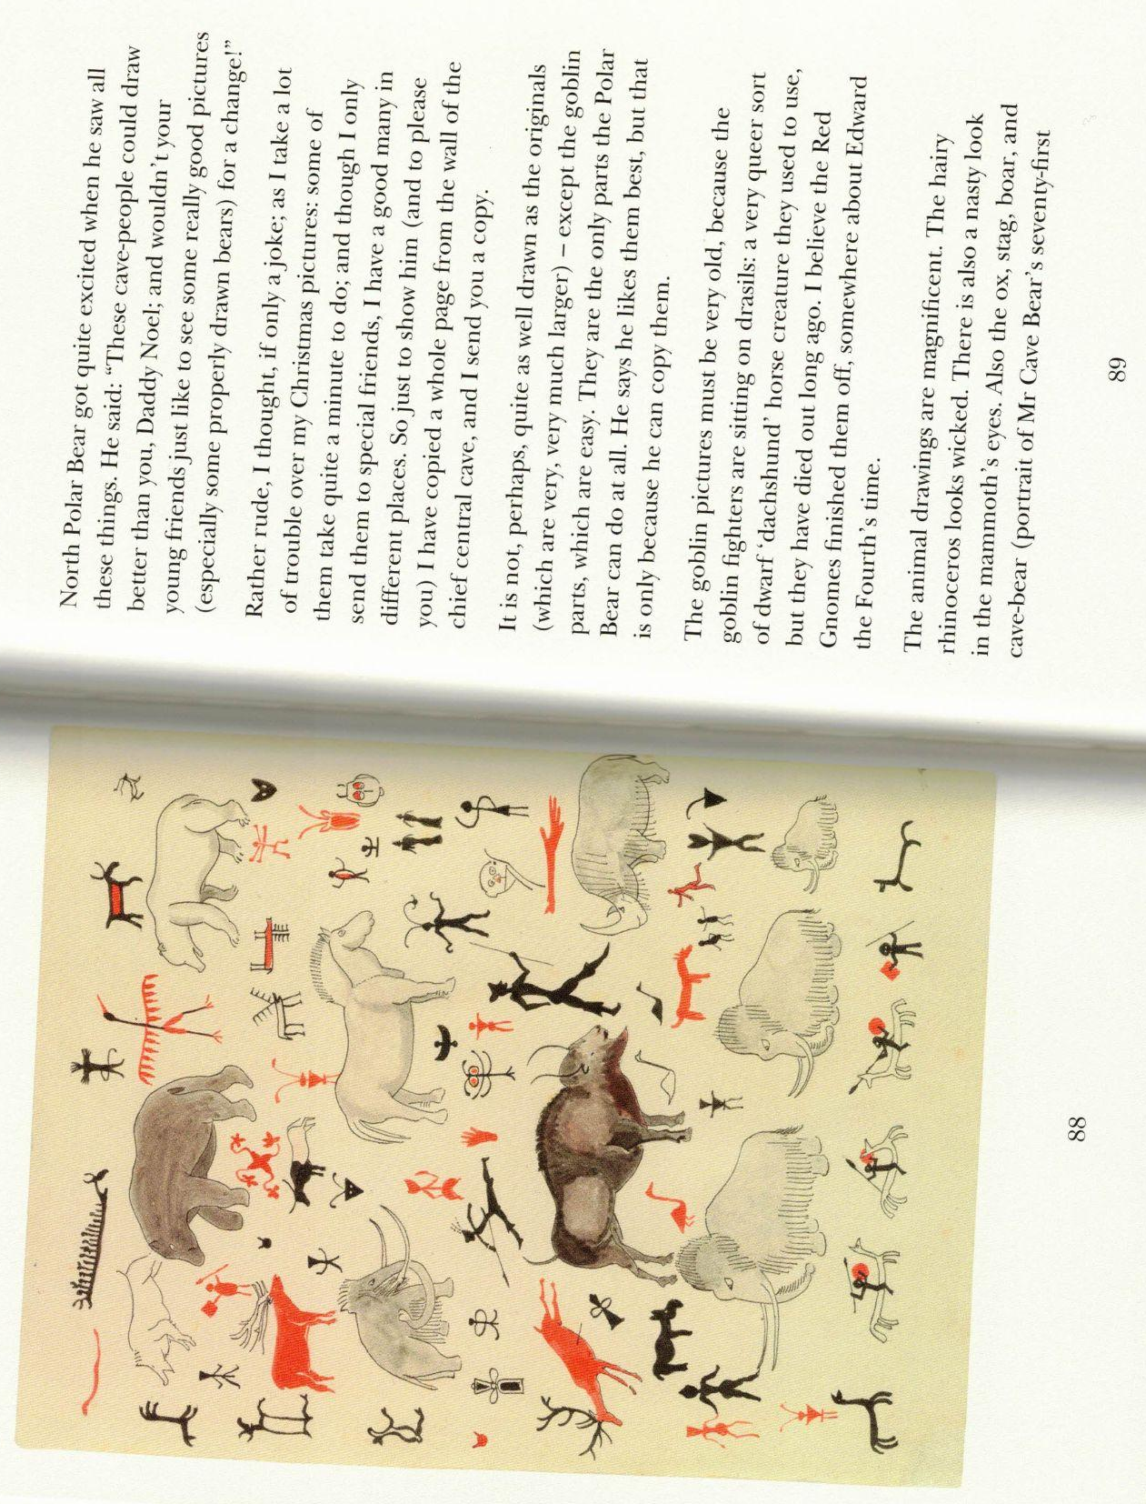

Slide 23
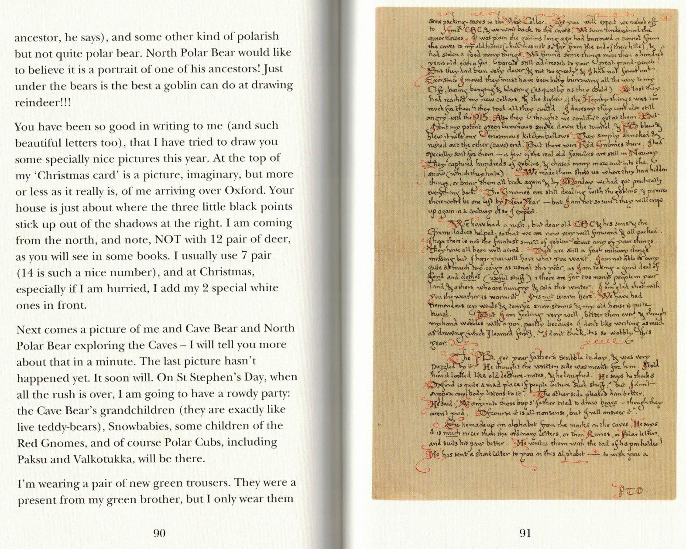

Slide 24
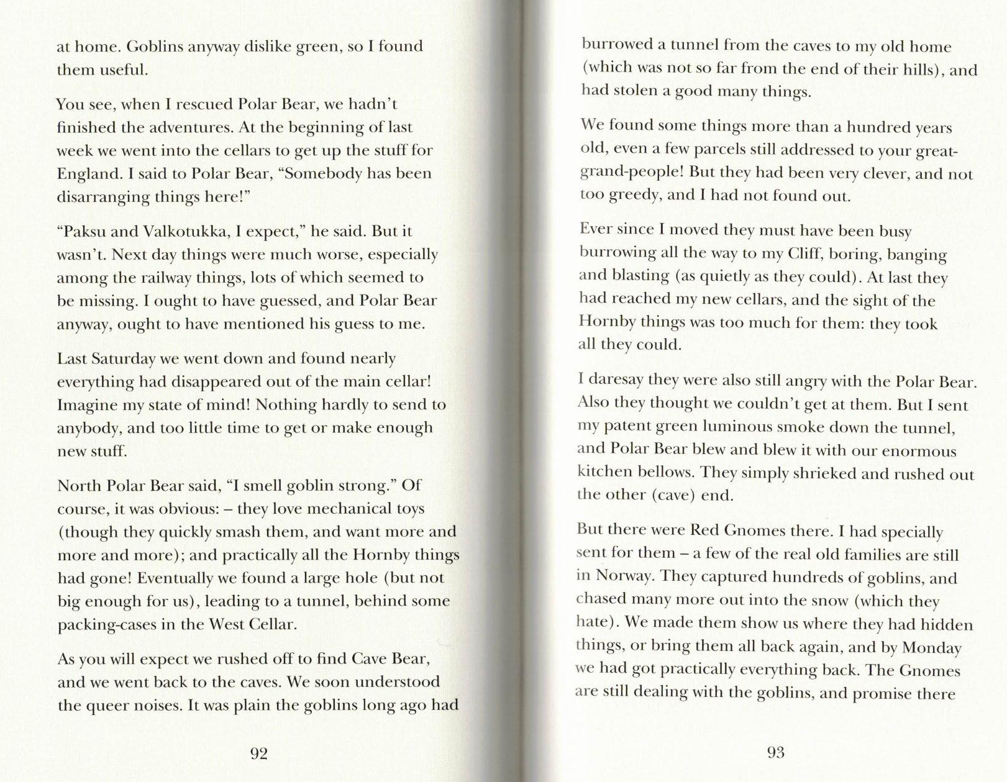

Slide 25
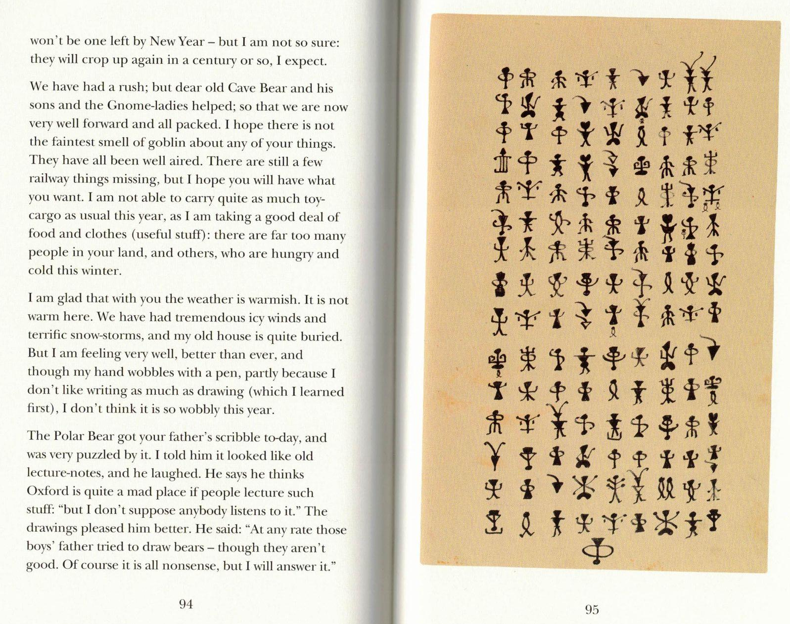

Slide 26
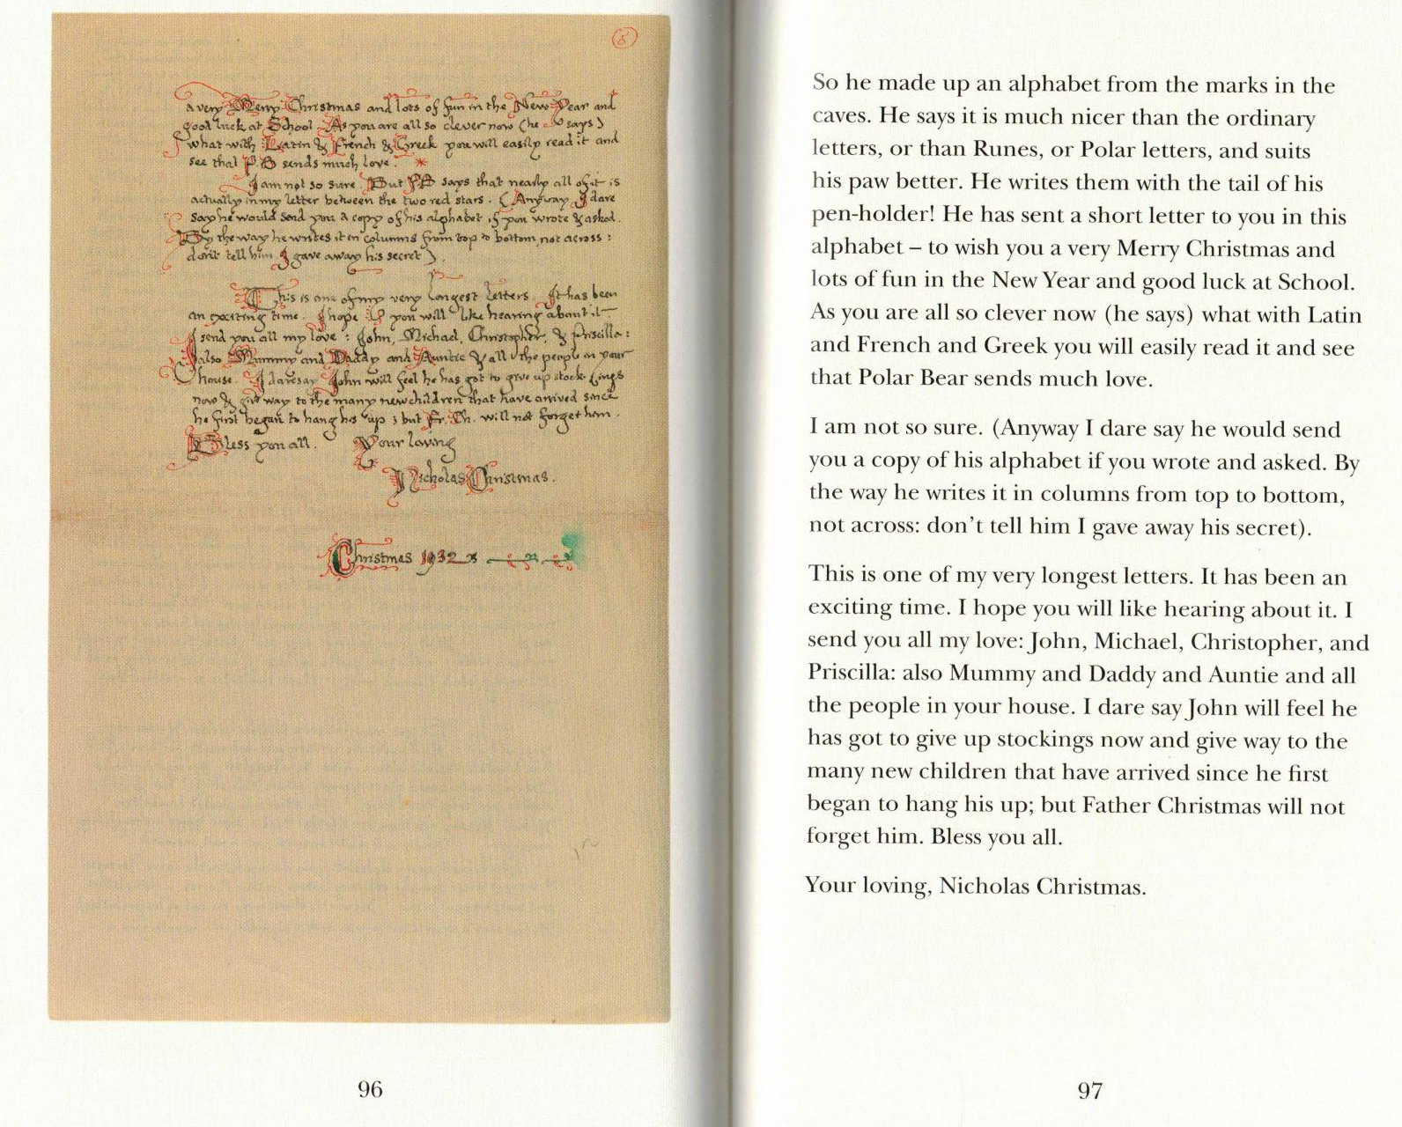

Slide 27
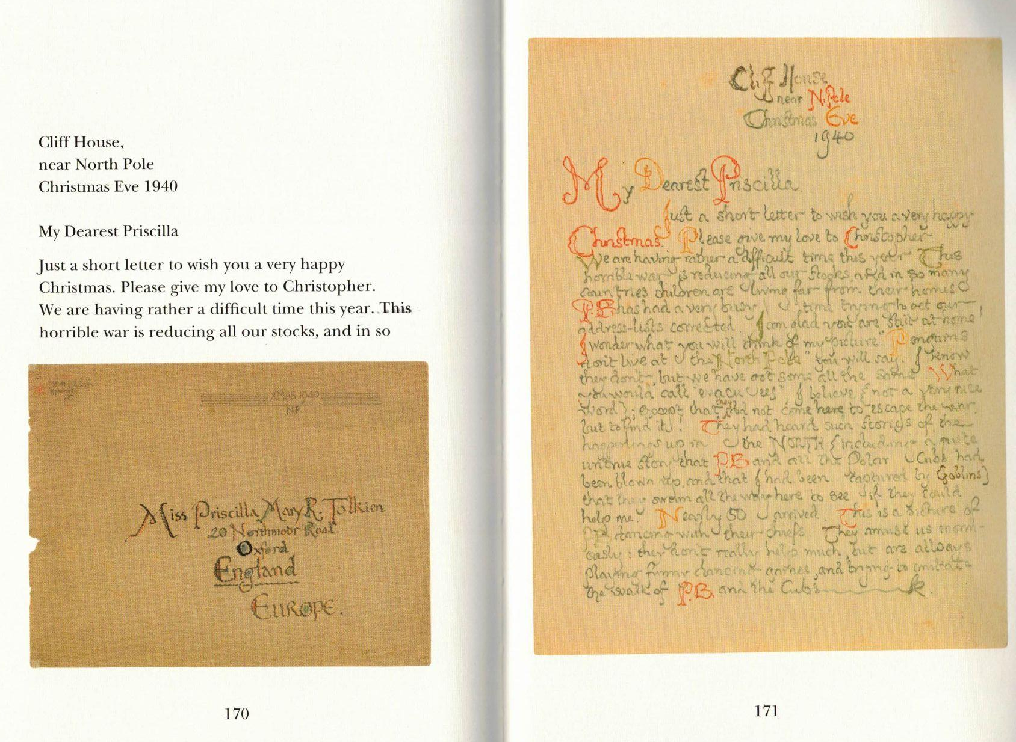

Slide 28
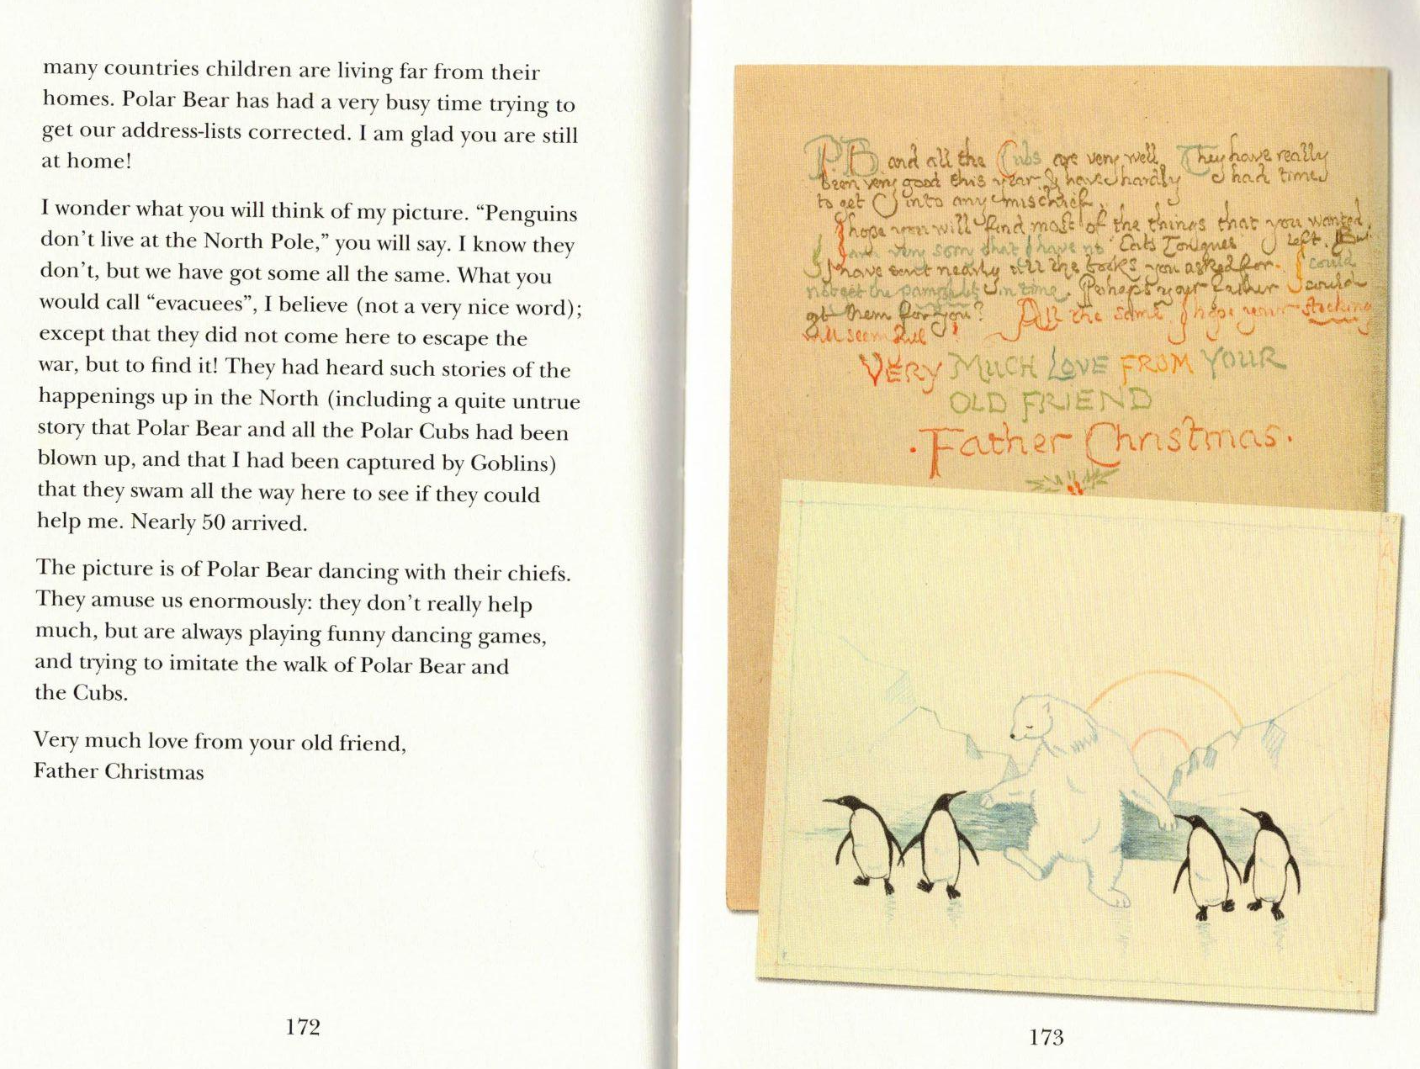

Slide 29
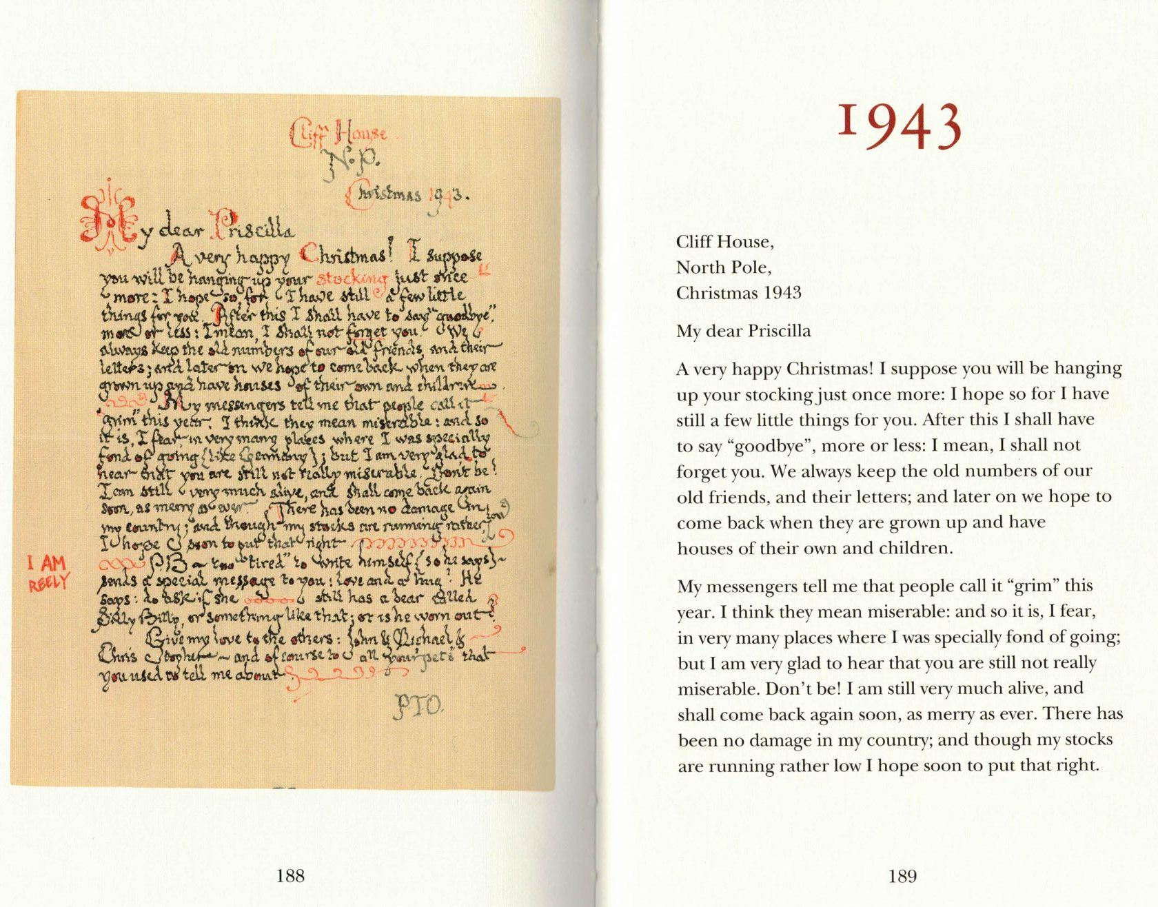

Slide 30
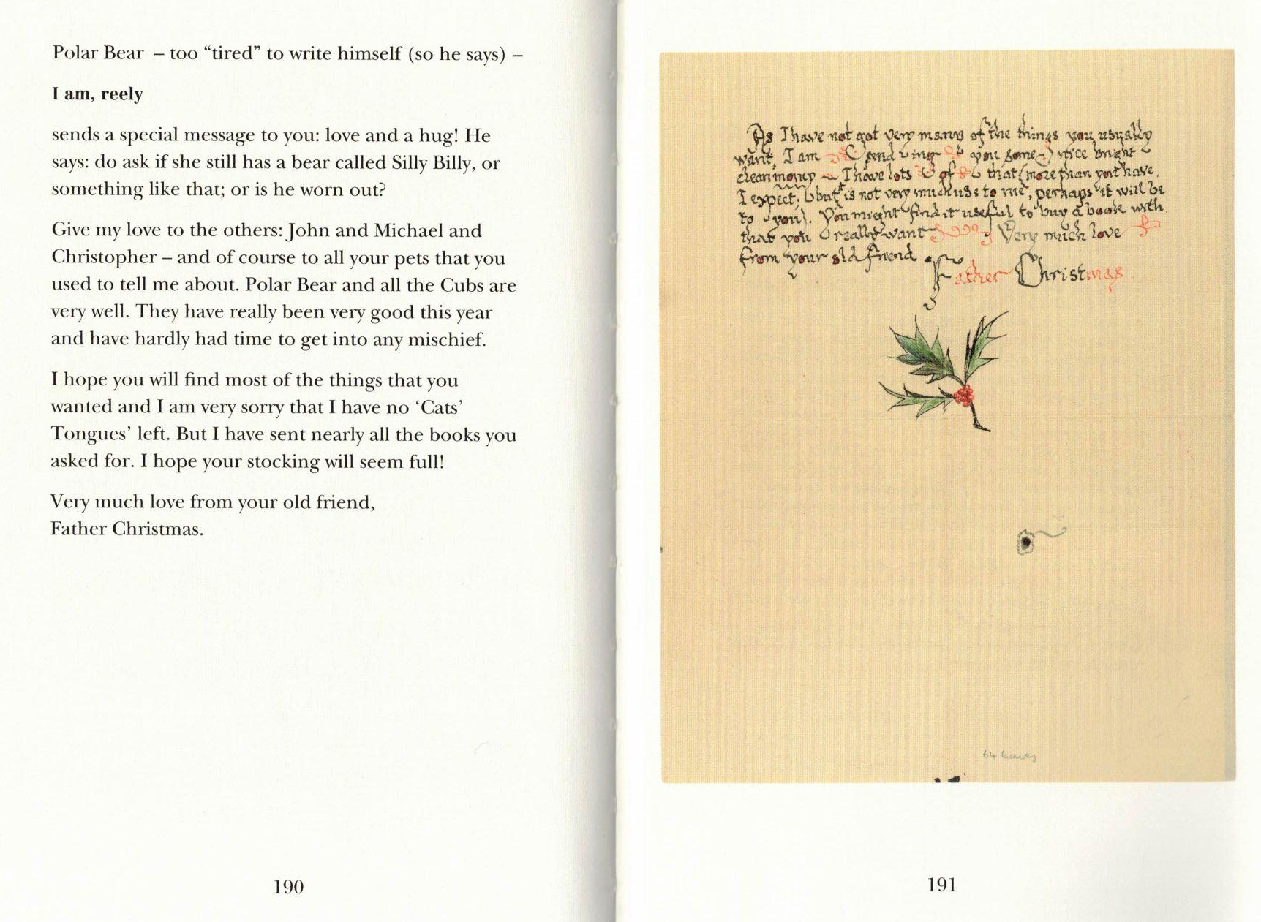

Slide 31
Letters from Father Christmas
How do the letters change with time? In what aspects? Length, themes, style, vocabulary used…?
From letter 1925, what is characteristic of Polar Bear writing?
From letter December, 23rd, 1932, what aspects related to Unit 4 can you identify?
Others?

Slide 32
Letters from Father Christmas
Final task:
Write a Christmas letter as if you were Father Christmas to children living in a place of conflict right now.
Use grammar of Unit 4: discursive markers (and (try) an inversion)
Use some vocabulary of conflict, yet, in the context of a Christmas letter
200 words aprox. Use the template.

Slide 33
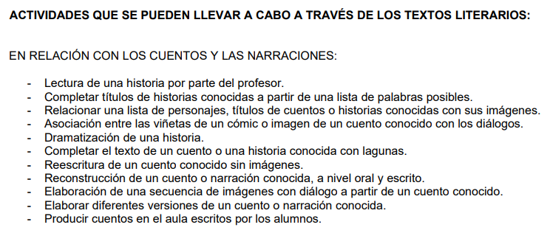
Letters from Father Christmas
opción 2 - SEGUIR LESSON PLAN: https://luke-shelton.com/2018/12/08/letters-from-father-christmas/
https://archivos.csif.es/archivos/andalucia/ensenanza/revistas/csicsif/revista/pdf/Numero_4/zenaidaalonsosanchez_laliteratura.pdf

