Slide 1
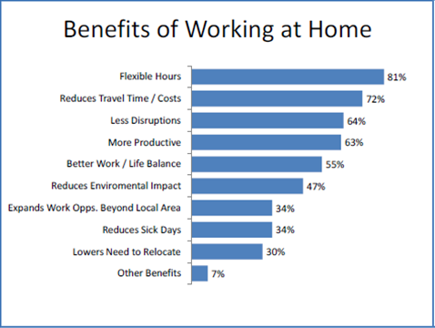
From: http://www.questcloudcomputing.co.uk/top-10-benefits-home-working-employers/

