Slide 1
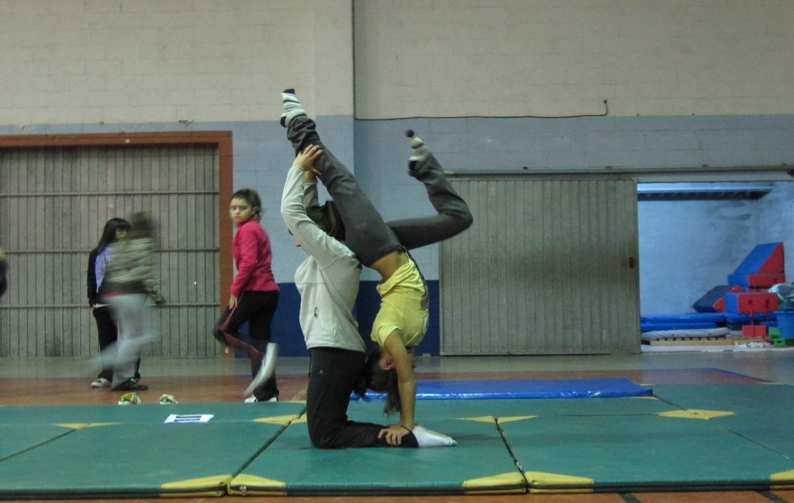
Acrosport
2011 -12

Slide 2
Acrosport

Slide 3
Acrosport

Slide 4
Acrosport

Slide 5
Acrosport

Slide 6
Acrosport

Slide 7
Acrosport

Slide 8
Acrosport

Slide 9
Acrosport

Slide 10
Acrosport

Slide 11
Acrosport

Slide 12
Acrosport

Slide 13
Acrosport

Slide 14
Acrosport

Slide 15
Acrosport

Slide 16
Acrosport

Slide 17
Acrosport

Slide 18
Acrosport

Slide 19
Acrosport

Slide 20
Acrosport

Slide 21
Acrosport

Slide 22
Acrosport

Slide 23
Acrosport

Slide 24
Acrosport

Slide 25
Acrosport

Slide 26
Acrosport

Slide 27
Acrosport

Slide 28
Acrosport

Slide 29
Acrosport

Slide 30
Acrosport

Slide 31
Acrosport

Slide 32
Acrosport

Slide 33
Acrosport

Slide 34
Acrosport

Slide 35
Acrosport

Slide 36
Acrosport

Slide 37
Acrosport

Slide 38
Acrosport

Slide 39
Acrosport

Slide 40
Acrosport

Slide 41
Acrosport

Slide 42
Acrosport

Slide 43
Acrosport

Slide 44
Acrosport

