Slide 1
Ramón Nicolás Rodríguez
Brais Martínez Fernández
2º BAC-A

Slide 2
Index:
Biography
Awards
Writing
Curiosities

Slide 3
Biography
He was born in Vigo on 9 June 1966, in Berbés, specifically in the Red Cross Hospital. He lived all his life in the area of Calvario and Llorons. He graduated in Galician-Portuguese Philology in Compostela, and later worked as a secondary school teacher in Vigo and at the University of Vigo. He is a literary critic as well as a writer and participated in many areas of Galician literature, such as television.

Slide 4
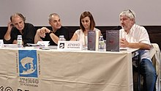
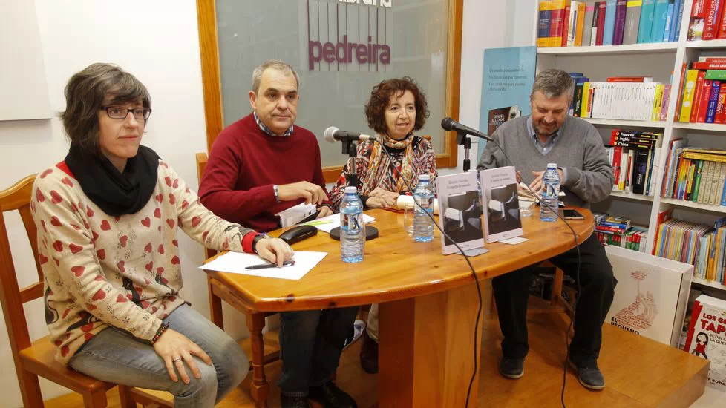
Awards
He received quite a few awards during his literary career, among them: prize for editorial cooperation in 2004 for his work as literary critic in the publishing house "Biblioteca das Letras Galegas de Edicións Xerais de Galicia"; he was rated as best critic four years in a row in the website "Fervenzas literarias"; his translation of "30 grams", by Leonel Moura, was awarded the Lois Tobío Prize for the best translation in 2011, among many more awards he has.

Slide 5
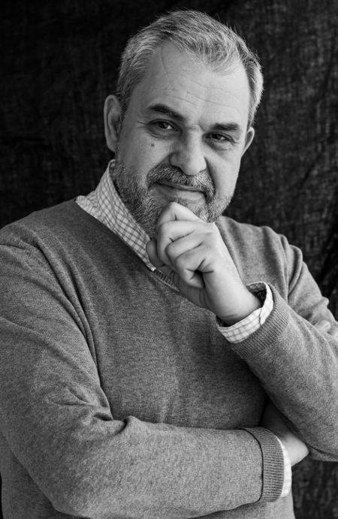
Writing
His works include literary criticism, biographies, a blog, essays, narrative and translations.He started his blog 10 years ago, as a way of organising all his information, and organising his literary reviews, which he had already started to write 20 years ago, publishing them in magazines and newspapers, and some in digital format. With this blog he aims to help spread Galician literature, and the subject matter of his reviews is mostly related to literature, and a few others to various fields.

Slide 6
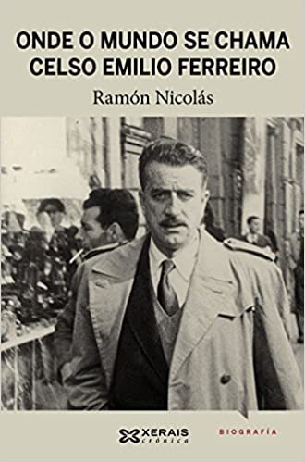
Biography Celso Emilio Ferreiro
It took him a long time to research the biography of Celso Emilio Ferreiro published in 2012, after 15 years of research and investigation, being his most extensive and complete biography. This biography and his work led to the creation of an almost family-like relationship between Ferreiro's family and Ramón. What motivated him and helped him to continue writing with more enthusiasm was this, about which he continues to write and publish books and essays.

Slide 7
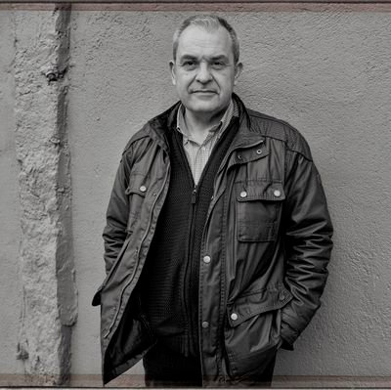
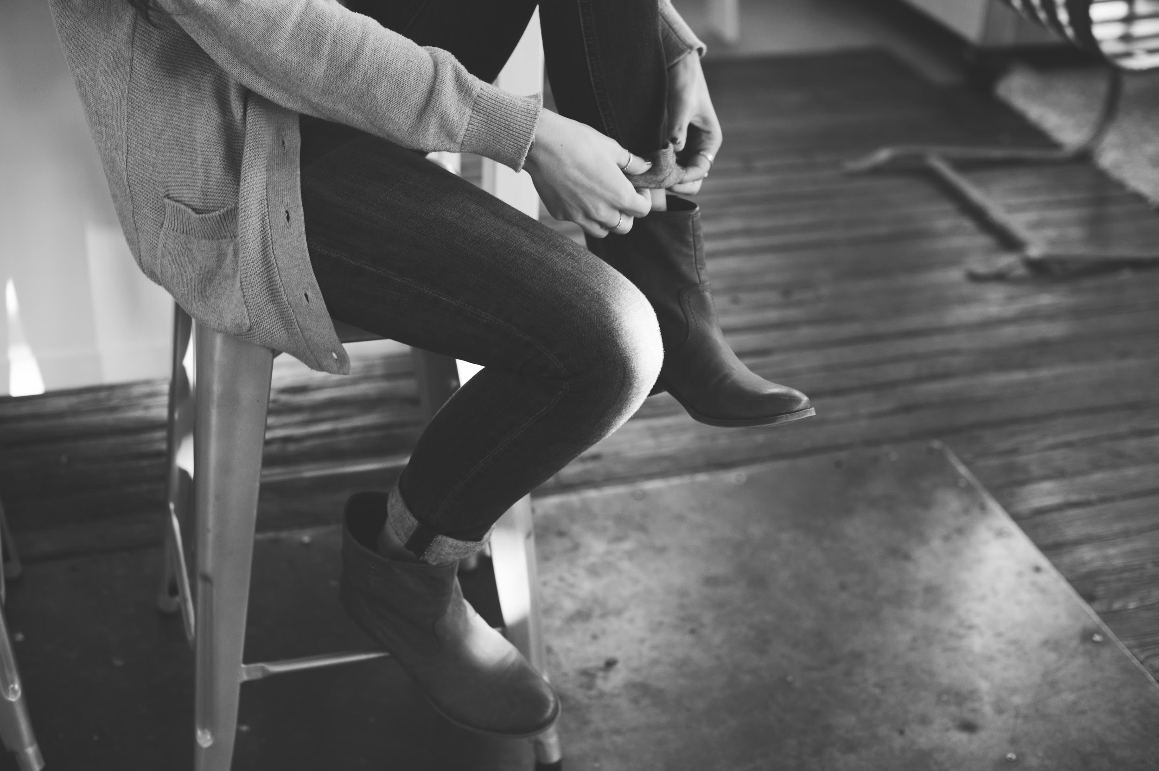
Writing
He wrote two important narrative works, as well as numerous essays and translations. As for his first and most relevant book, the motivation that led him to write it was mainly the opening to the field of writing, proving his worth as a writer, by publishing "O espello do Mundo". The book is about a character who lives in a rural and urban environment, and another German scientist character who talks to a nun in a female convent. The publication of this book was a source of satisfaction for him, even though it was not his first book, as he had already published other small books.

Slide 8
Curiosities
As for his writing method, it is not known if he has any "crutch" and his writing places are where he can concentrate, mainly and only at home.
His favourite literary genres are essays at the beginning and later on he changed to novels and poetry, until he reached comics in Galician.
He prefers pizza without pineapple, he likes pineapple, but far from pizza.
He prefers stew to churrasco, which is his favourite food.
He doesn't have an exclusive favourite film, but he chose Paris, Texas.
He doesn't have a favourite pupil but we all know it's David.
And his Galician team is Celta.

Slide 9
